Slide 1



Creating Graphical User Interface
(GUI & Swing, Part 4)
How to use Trees

Slide 2
Why should we study this lecture?
How to present hierarchical data on a GUI?
How to manage events on a tree?

Slide 3
Contents
The javax.swing.JTree class
A Demonstration

Slide 4
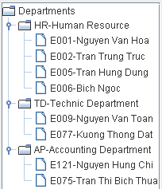
1- The JTree Class
A view for hierarchical data.
Data in a tree are presented as an aligned list. So, we can identify a node when clicking the mouse.
The model of JTree contains a group of nodes (the DefaultMutableTreeNode class) in which the root is the upmost node. Each node can contain its individual data.
At a time, a branch of the tree is selected (TreePath). The JTree.getSelectionPath() will return the current selected path and the TreePath.getLastPathComponent() will return the last node in the path.

Slide 5
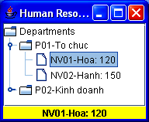
JTree: Architecture
class JTree
{ treeModel;
selectionModel;
cellRenderer;
cellEditor;
….
}
inteface TreeModel
inteface TreeCellRenderer
class DefaultTreeModel
class DefaultTreeCellRenderer
inteface TreeSectionModel
inteface CellEditor
class DefaultTreeSelectionModel
inteface TreeCellEditor
Model: User object
class DefaultTreeCellEditor
NV01
Hoa
120
View: Node of tree
class DefaultMutableTreeNode
inteface MutableTreeNode
inteface TreeNode

Slide 6
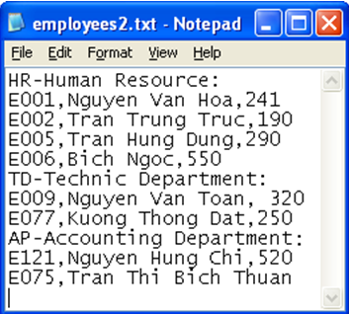
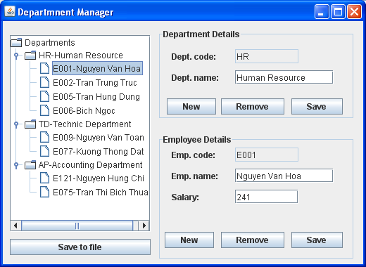
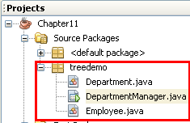
Demo 9 - 1: Using JTree

Slide 7
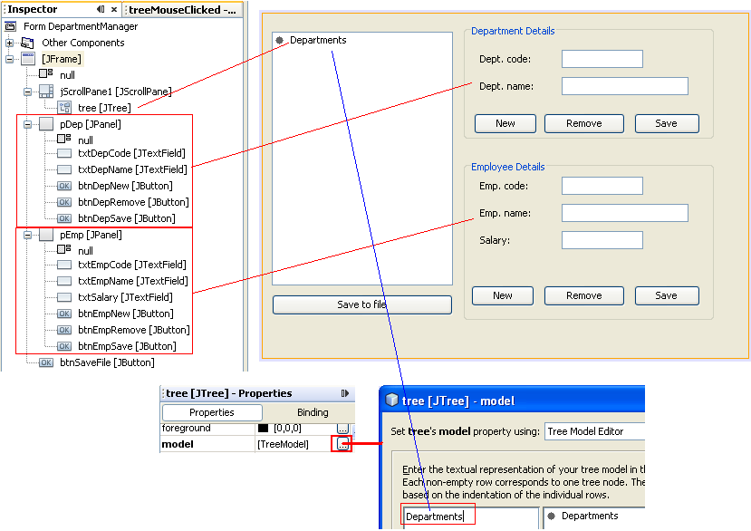
Demo 9 - 2: Using JTree…

Slide 8
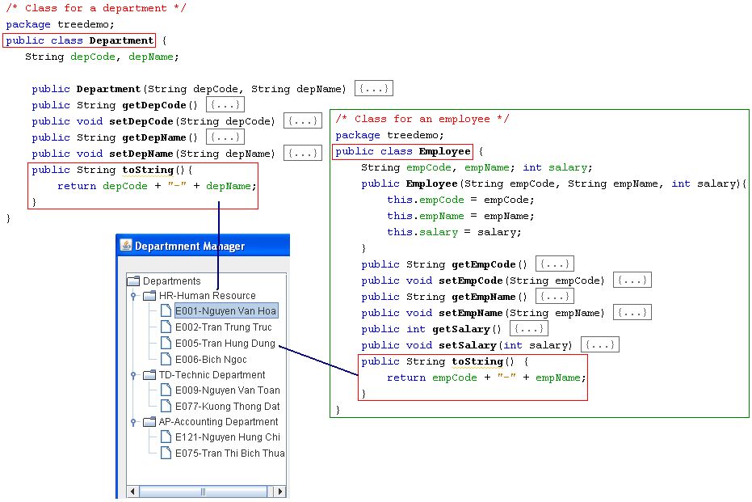
Demo 9 - 3: Using JTree…

Slide 9
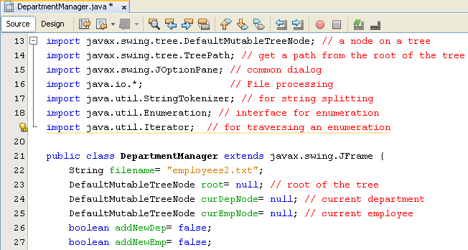
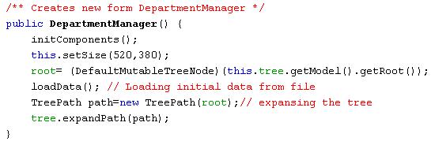


Demo 9 - 4: Using JTree…

Slide 10
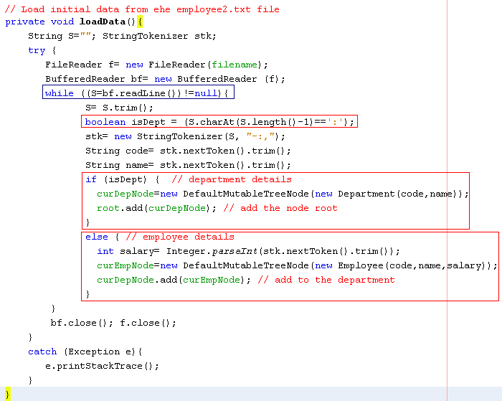
Demo 9 - 5: Using JTree…

Slide 11
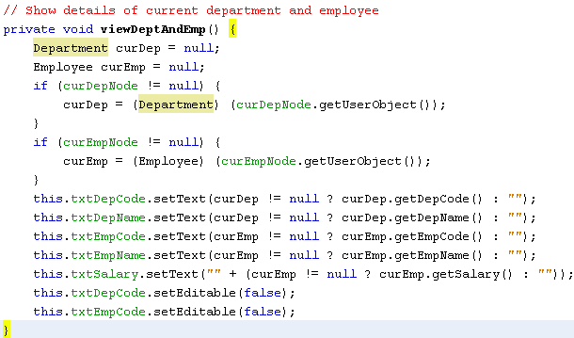
Demo 9 - 6: Using JTree…

Slide 12
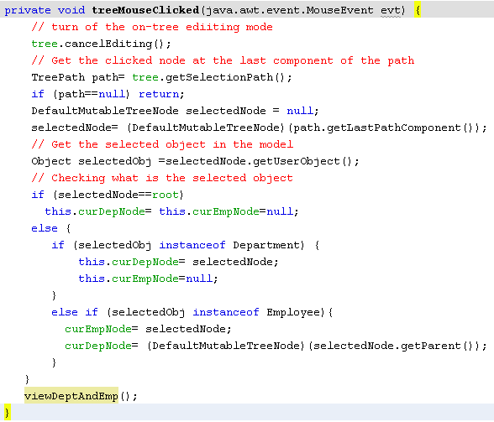
Demo 9 - 7: Using JTree…
addNewDept=addNewEmp=false;

Slide 13
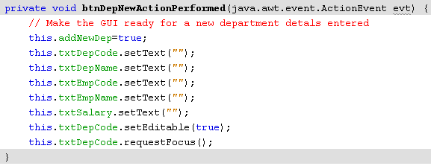
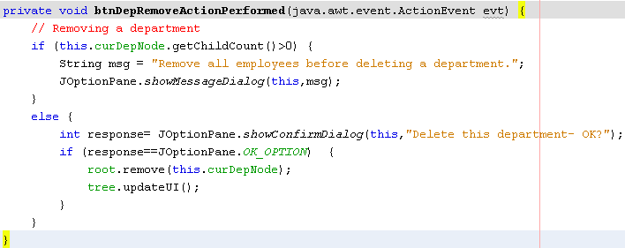
Demo 9 - 8: Using JTree…
curDepNode=curEmpNode=null;
( the department was removed)

Slide 14
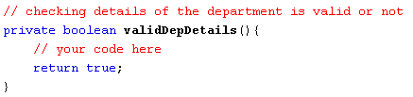
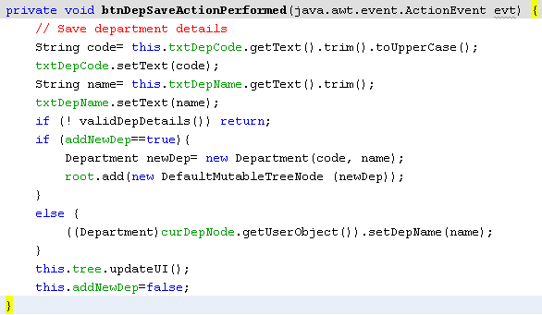
Demo 9 - 9: Using JTree…
curDepNode=curEmpNode=null;

Slide 15
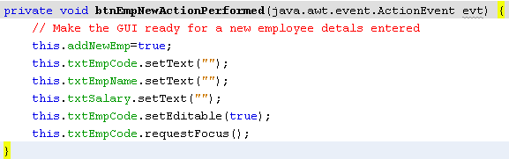
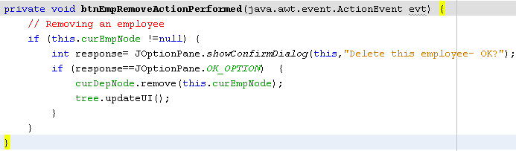
Demo 9 - 10: Using JTree…
curEmpNode=null;

Slide 16
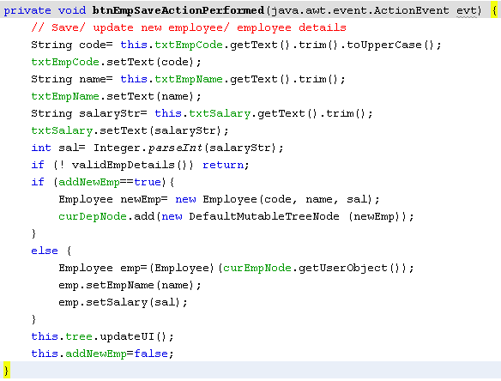

Demo 9 - 11: Using JTree…

Slide 17
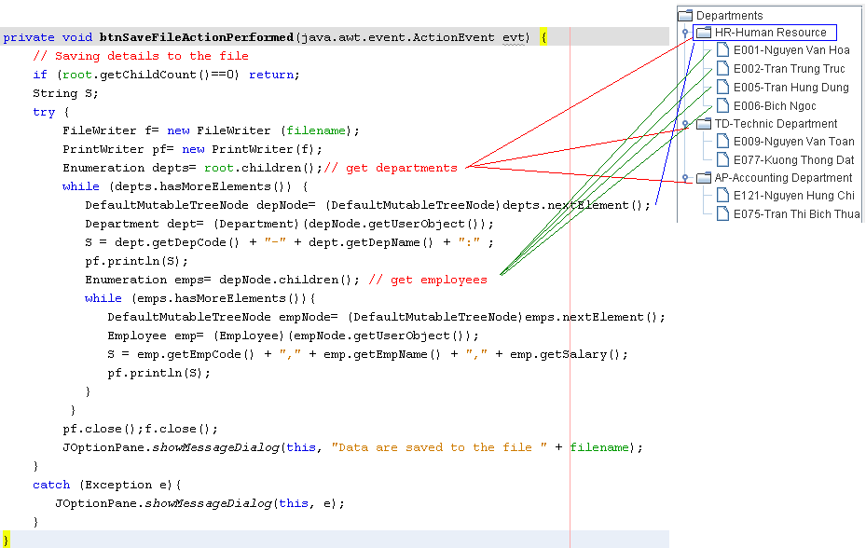
Demo 9 - 12: Using JTree…

Slide 18
Summary
The javax.swing.JTree class
A Demonstration

